Slide 1

EY Techathon 6.0 Executive Summary
Date of submission:

Slide 2
PHARMA INNOVATION AGENTS
Decisions in hours, not weeks.
Stop spending weeks on manual pharma research.
Pharma Innovation Agents is the AI platform that unifies all your market, clinical, trade, and patent data into one intelligent workspace.
Powered by advanced multi-agent AI, the system doesn't just collect information it has a dedicated Decision Agent that analyzes, ranks, and explains every recommendation.
The Benefit:
Accuracy, traceability, and speed across all R&D and strategy workflows. Get to your next breakthrough faster.

Slide 3





ABOUT US
TEAM NAME:DEVIGN
RAJ SHEKHAR JHA
Backend & Agent Orchestration:
FastAPI/LangGraph design, async task routing, evidence-quality gating, API contract ownership.
PRIYA ARUN SINGH
Data Intelligence & Reporting:
ETL over IQVIA/EXIM/patent/trials mocks, pandas/sqlalchemy fluency, PDF/XLS report assembly, cache/memory tuning.
HARSH TICKU
Frontend UX & Visualization:
React + Vite + Tailwind, Query Builder state management, Recharts/SMILES/3Dmol visual layers, download workflows.
SAURABH SINGH
Cheminformatics & AI Modeling:
RDKit heuristics, ADMET/radar visual logic, bias & reliability suites, molecule generation guardrails.
SHREYA AGGARWAL
DevOps, Integration & QA:
Docker Compose + Nginx delivery, env/CORS wiring, monitoring/logging scripts, pytest/LangGraph smoke automation.

Slide 4
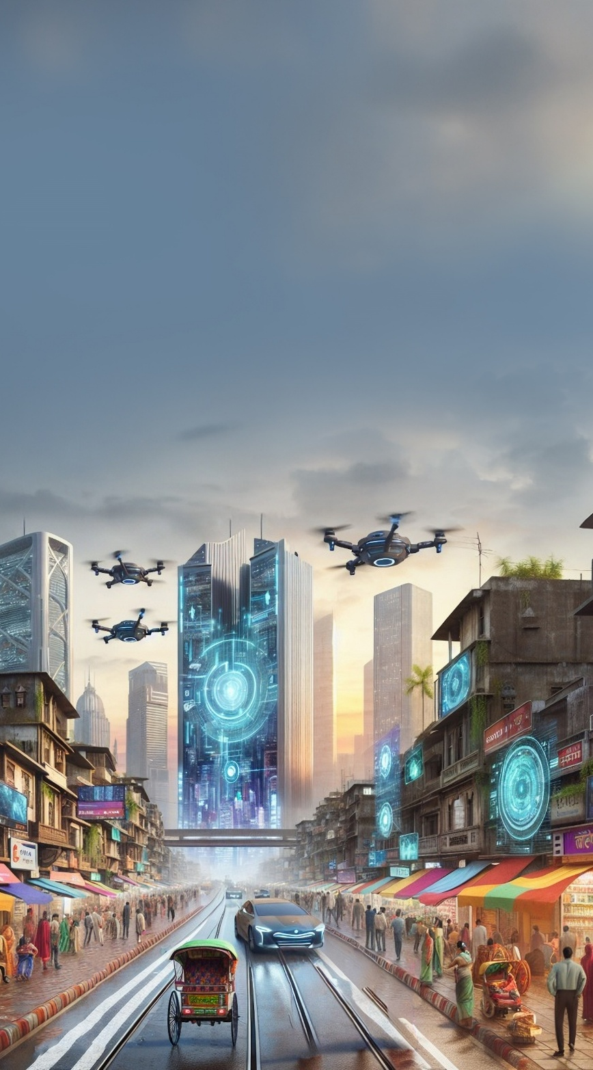
THE PHARMA DATA PROBLEM – WHY IT MATTERS
SLOW & MANUAL DECISIONS
LACK OF TRACEABILITY
DATA OVERLOAD
100+ fragmented sources
Unstructured PDFs, reports
2–4 weeks per analysis
$Billions wasted in manual effort
Manual expert-driven workflows
High error & bias risk
Missed strategic opportunities
Sluggish go-to-market timelines
No audit trails
Fragmented insights
Hard to validate decisions
High compliance & regulatory risk
Pharmaceutical decision making is slow, costly, and fragmented leading to delayed drug launches and billions in lost opportunities.

Slide 5
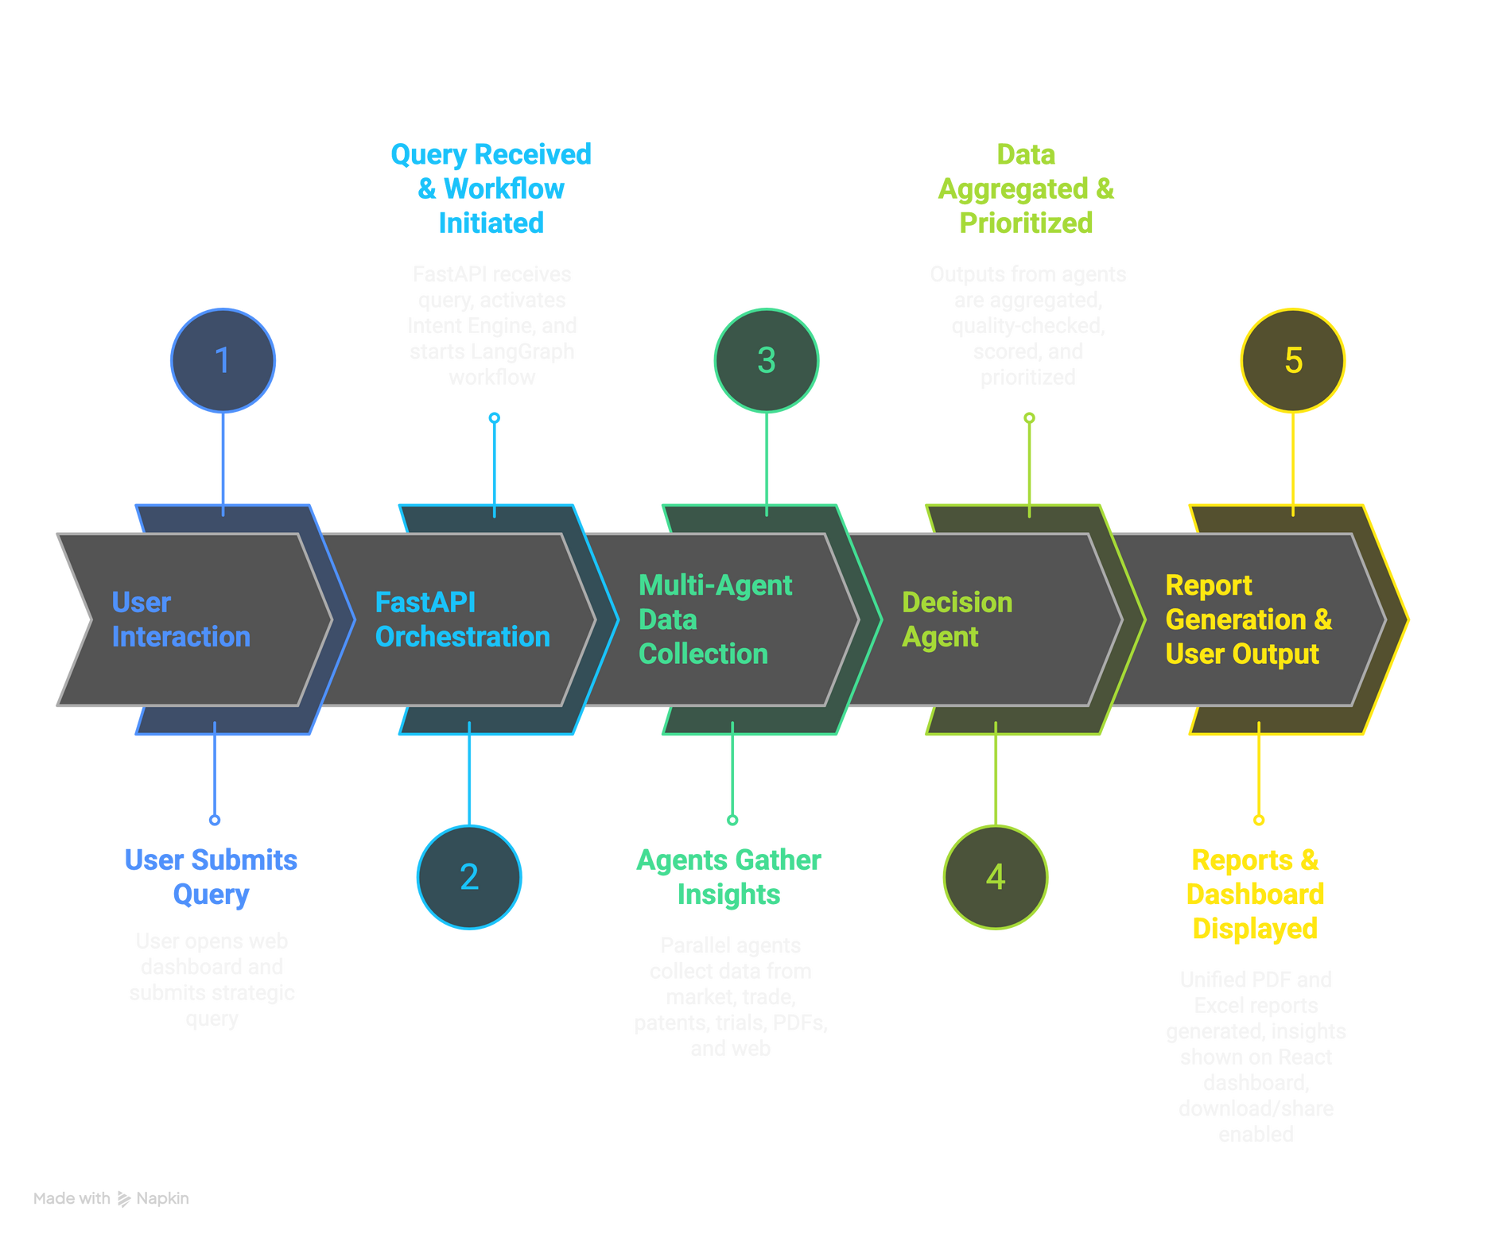
OUR AI-DRIVEN APPROACH TO SOLVING THE PROBLEM
USER JOURNEY
FORM FACTOR
Web Application with interactive React Dashboard and automated PDF/Excel reporting.
KEY USER GROUP
Pharma Strategy & R&D Teams
OUTCOME
The platform merges diverse pharma intelligence into one decision-ready workspace.
The Decision Agent stands at the core synthesizing all insights, ranking opportunities, and ensuring transparent, evidence-based strategies.

Slide 6
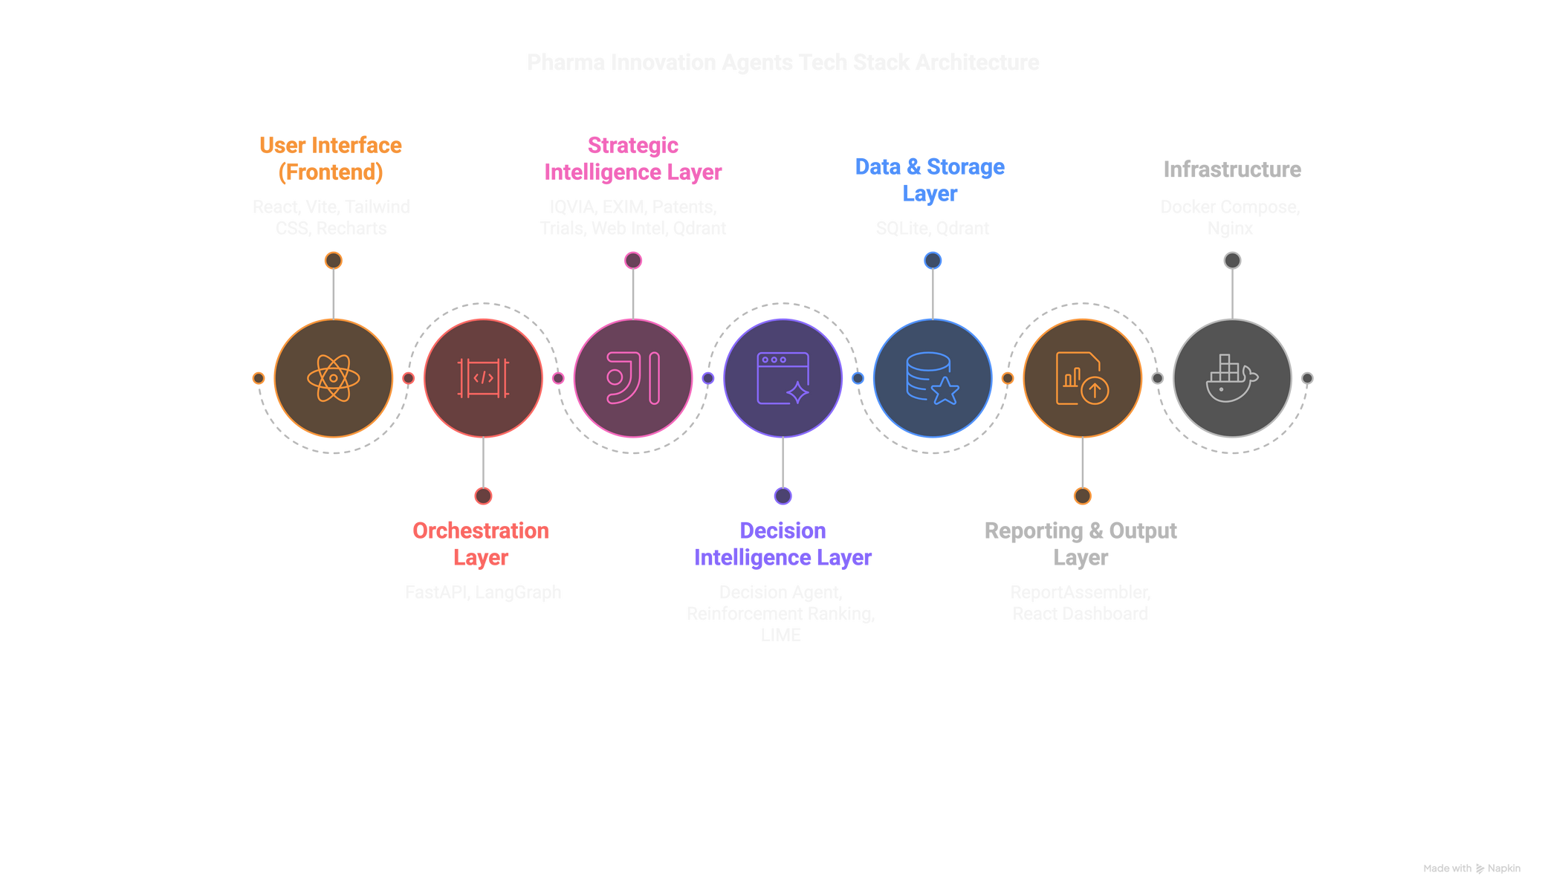
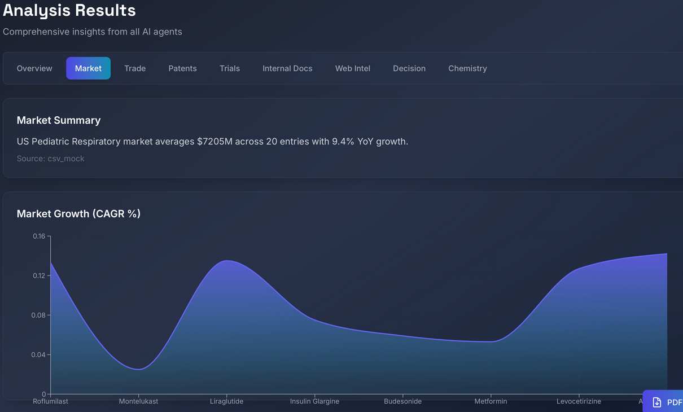
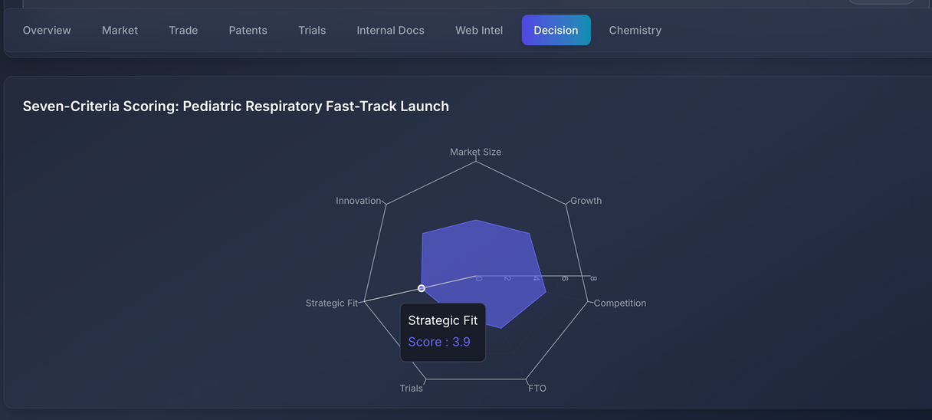
PLANNED SOLUTION DESIGN
TECH STACK ARCHITECTURE
Smart Multi-Layered Stack : blends intelligence, decision & reporting seamlessly
Frontend: React + Vite + Tailwind for fast, smooth, responsive UI
Backend: FastAPI × LangGraph powering multi-agent orchestration
Data Layer: SQLite + Qdrant enabling hybrid (structured + vector) retrieval
Decision Layer: LIME + Reinforcement Ranking = explainable, optimized insights
Infra: Docker + Nginx ensures scalable, secure, and stable deployment
Fig. 1 & Fig. 2 – Screenshots from the working Pharma Innovation Agent tool
Fig. 1 – Market Growth Dashboard: Tracks market trends and growth patterns
Fig. 2 – Opportunity Scoring Radar: Ranks opportunities across key criteria.
DEMONSTRATION LINK:LINK

Slide 7
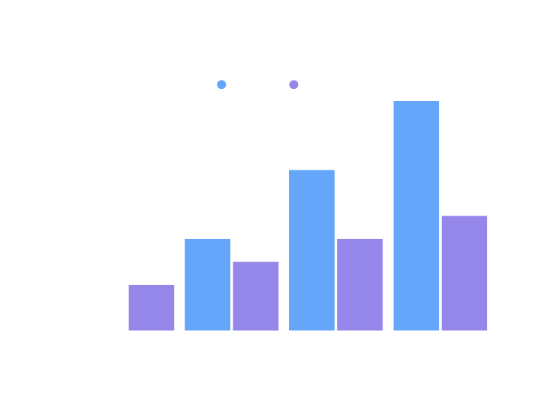

POTENTIAL BENEFITS & ROI IMPACT
METRIC
TRADITIONAL
WITH PHARMA AI
BENEFIT
TIME TO INSIGHTS
2-3 weeks[Link]
4-6 hours
Generate evidence 85–90% faster
ANALYST SPEED LAUNCH
₹10-12 Cr[Link]
₹4 -5 Cr
₹6-8 Cr savings
SPEED
8-10 weeks[Link]
2-3 weeks
6-8 weeks faster approvals
ROI
1×[Link]
4-5×
Up to 3× delivery & ₹ 1500 early access.
4× faster insights through automated multi-agent retrieval
₹8 Cr annual savings by reducing analyst hours
95 %+ decision accuracy with evidence-backed analysis
Cosine similarity 0.52 - high semantic precision
MMR diversity 4 / 5 - non-redundant, multi-source evidence
Drives faster, reliable, and ROI-positive decisions across pharma strategy
60-70[Link]
95%+ evidence-backed via
Bias reduced & ₹20–30C loss
averted
Decision Accuracy
(human dependent)
LIME & MMR.

Slide 8








Powered by India's leading enterprises
Thank you for your attention!

Slide 9


Ernst & Young LLP
EY | Building a better working world
EY is building a better working world by creating new value for clients, people, society and the planet, while building trust in capital markets.
Enabled by data, AI and advanced technology, EY teams help clients shape the future with confidence and develop answers for the most pressing issues of today and tomorrow.
EY teams work across a full spectrum of services in assurance, consulting, tax, strategy and transactions. Fueled by sector insights, a globally connected, multi-disciplinary network and diverse ecosystem partners, EY teams can provide services in more than 150 countries and territories.
All in to shape the future with confidence.
EY refers to the global organization, and may refer to one or more, of the member firms of Ernst & Young Global Limited, each of which is a separate legal entity. Ernst & Young Global Limited, a UK company limited by guarantee, does not provide services to clients. Information about how EY collects and uses personal data and a description of the rights individuals have under data protection legislation are available via ey.com/privacy. EYG member firms do not practice law where prohibited by local laws. For more information about our organization, please visit ey.com.
Ernst & Young LLP is one of the Indian client serving member firms of EYGM Limited. For more information about our organization, please visit www.ey.com/en_in.
Ernst & Young LLP is a Limited Liability Partnership, registered under the Limited Liability Partnership Act, 2008 in India, having its registered office at Ground Floor, Plot No. 67, Institutional Area, Sector - 44, Gurugram - 122 003, Haryana, India.
© 2025 Ernst & Young LLP. Published in India. All Rights Reserved.
This publication contains information in summary form and is therefore intended for general guidance only. It is not intended to be a substitute for detailed research or the exercise of professional judgment. Neither EYGM Limited nor any other member of the global Ernst & Young organization can accept any responsibility for loss occasioned to any person acting or refraining from action as a result of any material in this publication. On any specific matter, reference should be made to the appropriate advisor.

